Slide 1
Internetworking
Concepts, Architecture and Protocols

Slide 2
Motivation for Internetworking
Each network technology is designed to fit a specific set of constraints
No single networking technology is best for all needs
A large organization with diverse networking requirements needs multiple physical networks.
When the networking technology which is suitable for each task, many networking technologies must be used in the organization.

Slide 3
Universal Service
A communication system that supplies universal service allows arbitrary pairs of computers to communicate.
Universal service is desirable, because it increases individual productivity
Incompatibilities among network hardware and physical addressing prevent an organization from building a bridged network that include arbitrary technologies.

Slide 4
Internetworking
Internetworking scheme uses both hardware and software.
Hardware is used to interconnect a set of physical networks
Software provides universal service.
Resulting system is known as an internetwork or internet
Internetworking is quite general.
It is not restricted in size
The number of computers attached to each network in an internetwork can vary.

Slide 5
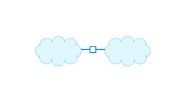
Physical Network Connection with Routers
A router is a special purpose system dedicated to the task of interconnecting networks.
A router can interconnect networks that use different technologies, including different media, physical addressing schemes and frame formats.

Slide 6
Internet Architecture
An internet consists of a set of networks interconnected by routers
The internet scheme allows each organization to choose the number and type of networks, the number of routers to use to interconnect them, and the exact interconnection topology.

Slide 7
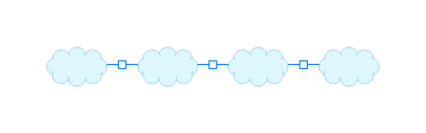
Internet Architecture (2)

Slide 8
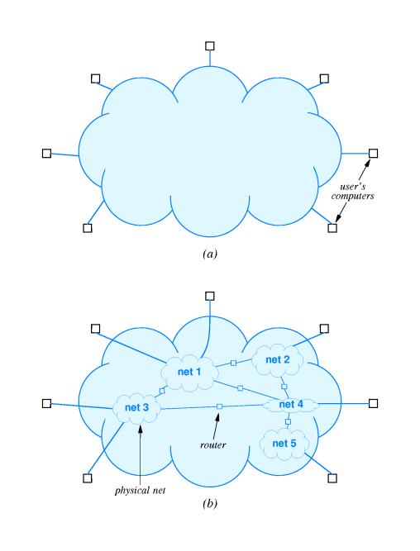
A Virtual Network
Internet is a virtual network system
The communication system is an abstraction
Any computer can send a packet to any other.

Slide 9
Protocols for Internetworking
TCP/IP Internet protocols suite
First set of protocols developed for use on internet
Researchers who developed TCP/IP also developed the internet architecture.

Slide 10
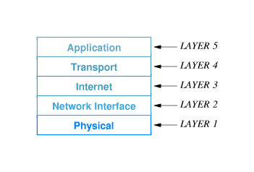
TCP/IP Layers
Layer1: Network Hardware
Layer 2: How to organize data into frames and how a computer transmits frames over a network.

Slide 11
TCP/IP Layers (2)
Layer 3: Format of packets sent across an internet as well as the mechanisms used to forward packets from a computer through one or more routers to a final destination
Layer 4: Ensure reliable transfer
Layer 5: Layer 6 and Layer 7 in ISO model

